Slide 1

Operating System Structures
BCSC 0004 -Operating Systems
Dhirendra Kumar Shukla
Assistant Professor
Computer Engineering & Applications
Institute of Engineering & Technology
GLA University, Mathura

Slide 2
What goes in to an Operating System?
System Call Interface
Memory
Management
CPU
Scheduling
File System
Management
Networking
Stack
Inter-process
Communication
Device Driver

Slide 3
Modern Operating System
A modern operating system is large and complex, if it is to be function properly and be modified easily, then it must be engineered very carefully.
A common approach is to partition the task into small components, or modules, rather than having one monolithic system.
Each of these modules should be a well-defined with inputs, outputs, and functions.

Slide 4
Types of Operating System Structures
Simple Structure
Monolithic Structure
Layered Approach
Microkernels
Modular Approach
Hybrid Systems

Slide 5
Simple Structure
Many operating systems do not have well-defined structure
Such system started as small, simple, and than grew up beyond their original scope
Example
MS-DOS

Slide 6
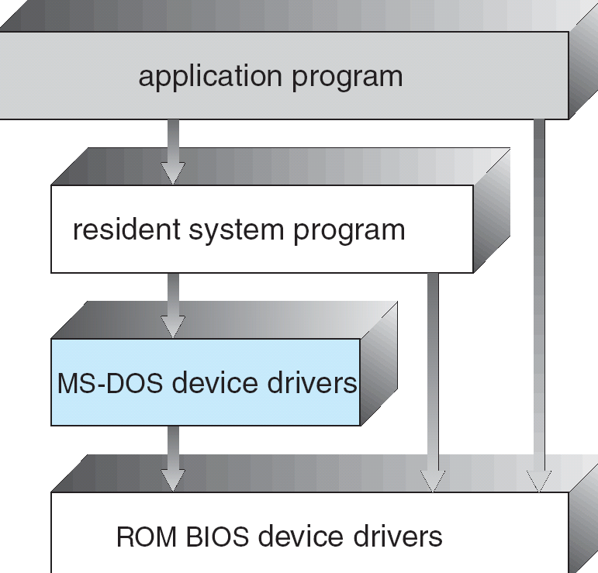
MS-DOS Simple Structure
MS-DOS – written to provide the most functionality in the least space
The interfaces and levels of functionality are not well separated
Vulnerable to malicious programs
Provide no dual-mode and no hardware protection

Slide 7
Monolithic Structure
User Space
KERNELSPACE
System Call Interface
Memory
Management
CPU
Scheduling
File System
Management
Networking
Stack
Inter-process
Communication
Device Driver
Pros: direct communication between modules in the kernel by procedural calls
Cons: Large size of code block, difficult to maintain and verify

Slide 8
UNIX
UNIX – limited by hardware functionality, the original UNIX operating system had limited structuring. The UNIX OS consists of two separable parts
Systems programs
The kernel
Consists of everything below the system-call interface and above the physical hardware
Provides the file system, CPU scheduling, memory management, and other operating-system functions; a large number of functions for one level

Slide 9
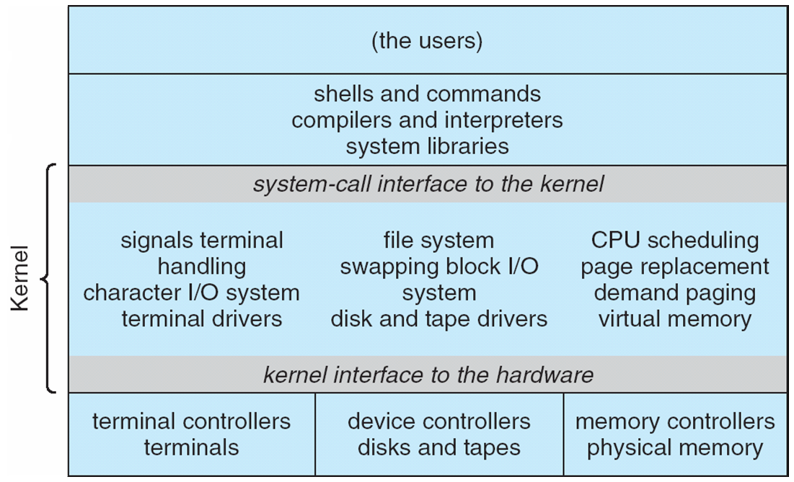
Traditional UNIX System Structure

Slide 10
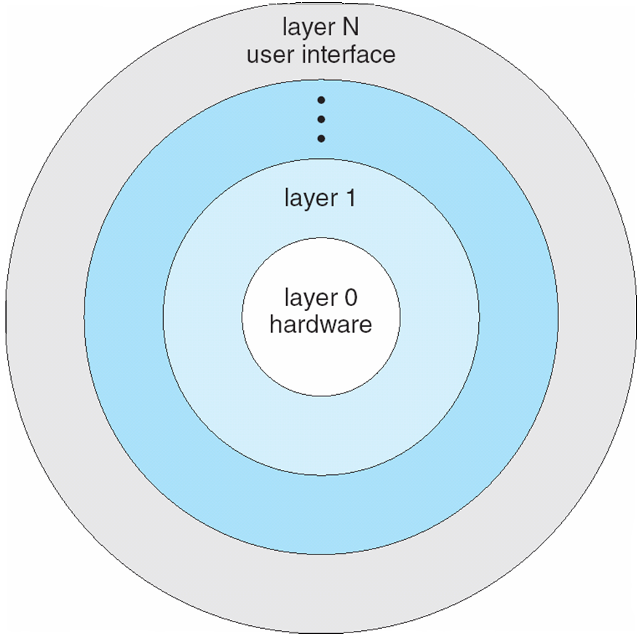
Layered Structure

Slide 11
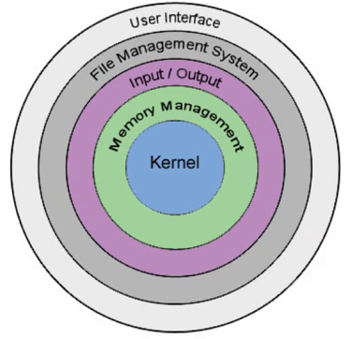
Layered Structure
OS is divided into number of layers (Levels) each build on the top of the lower level.
The Bottom Layer (Layer-0) is the Hardware Layer and highest layer (Layer-N) is the interface layer.
Upper layer can invoke operation on lower level layer.
The main advantage is MODULARITY.
The layers are selected such that each uses functionality of only lower level layers.
This approach simplifies the debugging and system verification.
Less efficient than others

Slide 12
Microkernel Structure
Highly Modular
Every components has its own space
Interaction between modules strictly through well defined interfaces
Kernel has basic inter-process communication and scheduling
Everything else in user space
Ideally kernel is so small.
User Space Processes
File Management
Process Server
Device Driver
Connected Devices
Microkernel Space
(Inter-process Communication, Scheduling)
Kernel
Space

Slide 13
Microkernel System Structure
Benefits:
Easier to extend a microkernel
Easier to port the operating system to new architectures
More reliable (less code is running in kernel mode)
More secure
Detriments:
Performance overhead of user space to kernel space communication

Slide 14
Modular Structure
The best current methodology for operating-system design involves using loadable kernel modules.
Here, the kernel has a set of core components and links in additional services via modules, either at boot time or during run time.
The idea of this design is for the kernel to provide core services while other services are implemented dynamically, as the kernel is running.
Linking services dynamically is preferable to adding new features directly to the kernel, which would require recompiling the kernel every time a change was made.

Slide 15
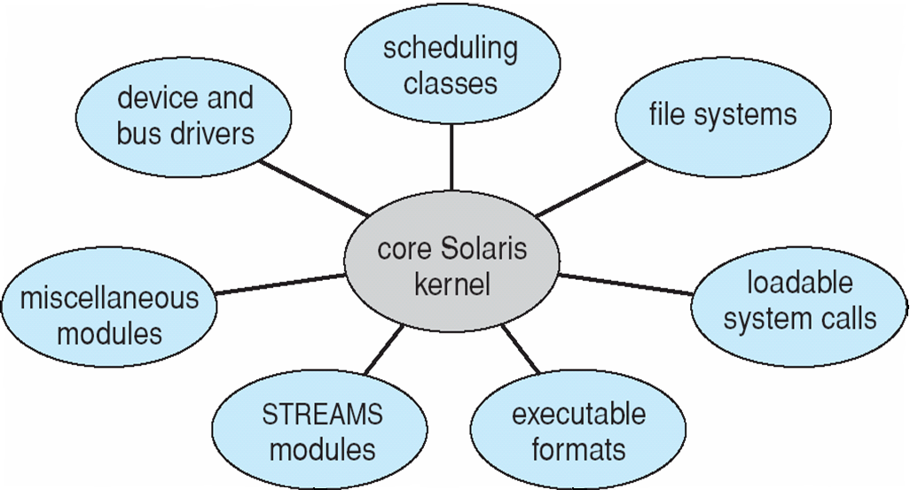
Solaris Modular Approach

Slide 16
Solaris Modular Approach
The Solaris operating system structure, shown in diagram, is organized around a core kernel with seven types of loadable kernel modules:
Scheduling classes
File systems
Loadable system calls
Executable formats
STREAMS modules
Miscellaneous
Device and bus drivers

Slide 17
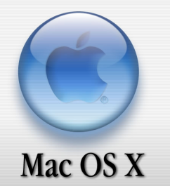

Hybrid Structure
In practice, very few operating systems adopt a single, strictly defined structure. Instead, they combine different structures, resulting in hybrid systems that address performance, security, and usability issues.
Three hybrid systems are well-known:
The Apple Mac OS X operating system
and the two most prominent mobile operating systems — iOS and Android.

Slide 18
Thanks to all

